Slide 1
Python – Introduction 1
STEM Resources

Slide 2
What we will do today?
Introduction
Setup Trinket Account
Learn some graphics + resources
https://trinket.io/docs/python#turtle
Drawing a Square - Together
In Class Exercise: Drawing a Triangle
- 10 mins on your own and we will do it together
Homework: Can you make a star with Turtle?
Next Class time?
Questions/Feedback

Slide 3
Introduce yourself
Name
Favorite Subject in School
What do you want to do when you grow up or a cool trick you know how to do?
Have you done coding before? If so, what did you enjoy?
What do you want to learn with Python?

Slide 4
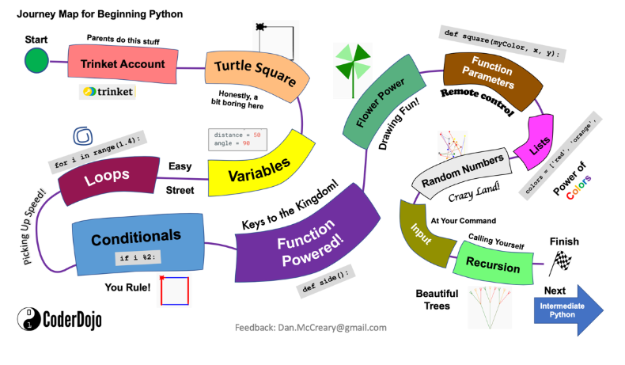

Slide 5
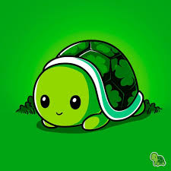
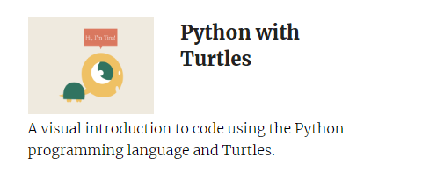
Setup Trinket account
https://trinket.io/
Click on Sign Up for your Free Account
Select Python with Turtles – Who does not like turtles?
https://repl.it/@VishalAtreAtre/GlossyWeirdSystemadministrator#main.py
Stands for Read, Eval, Print, Loop
Use this for practice

